Slide 1


Welcome and overview
EDDI PMM, 3-4th November 2016, Garching, Germany
Dr Michael Gorley,
EDDI Project Leader

Slide 2
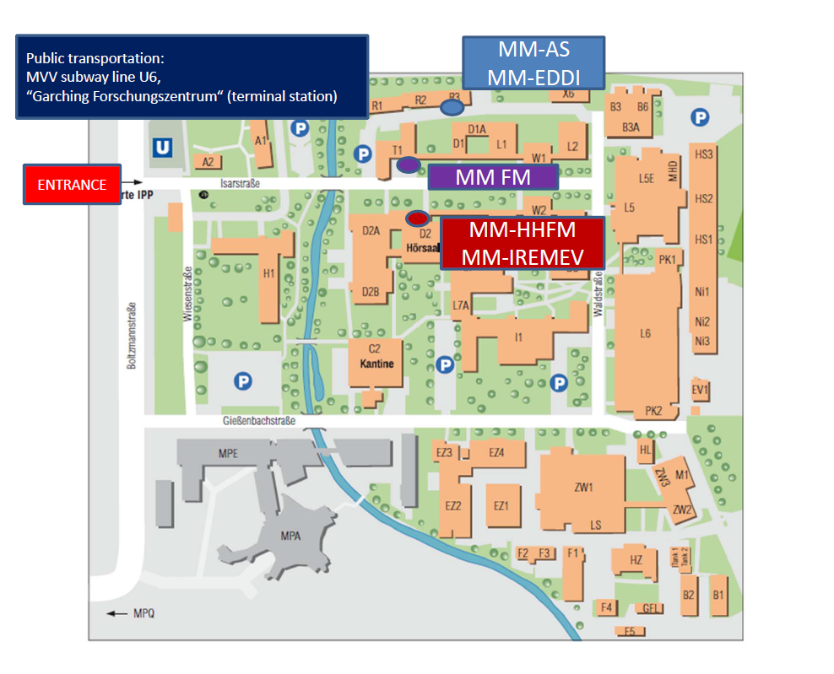
Welcome details
WPMAT
Safety information at Garching ….
Lunch will be at Kantine (at own cost), Coffee breaks will be in ….

Slide 3
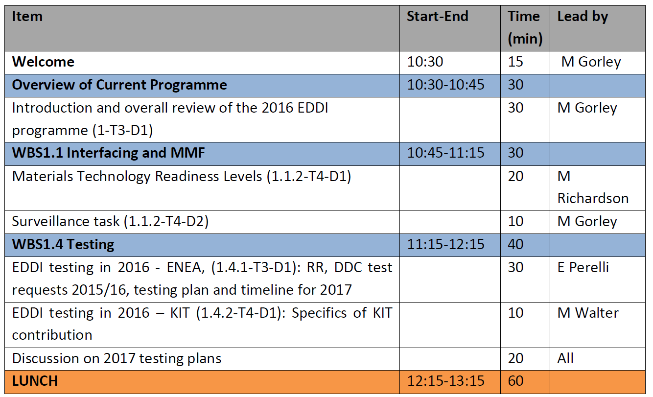
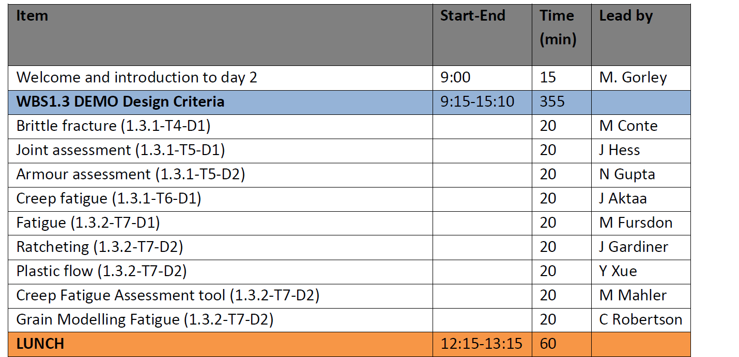
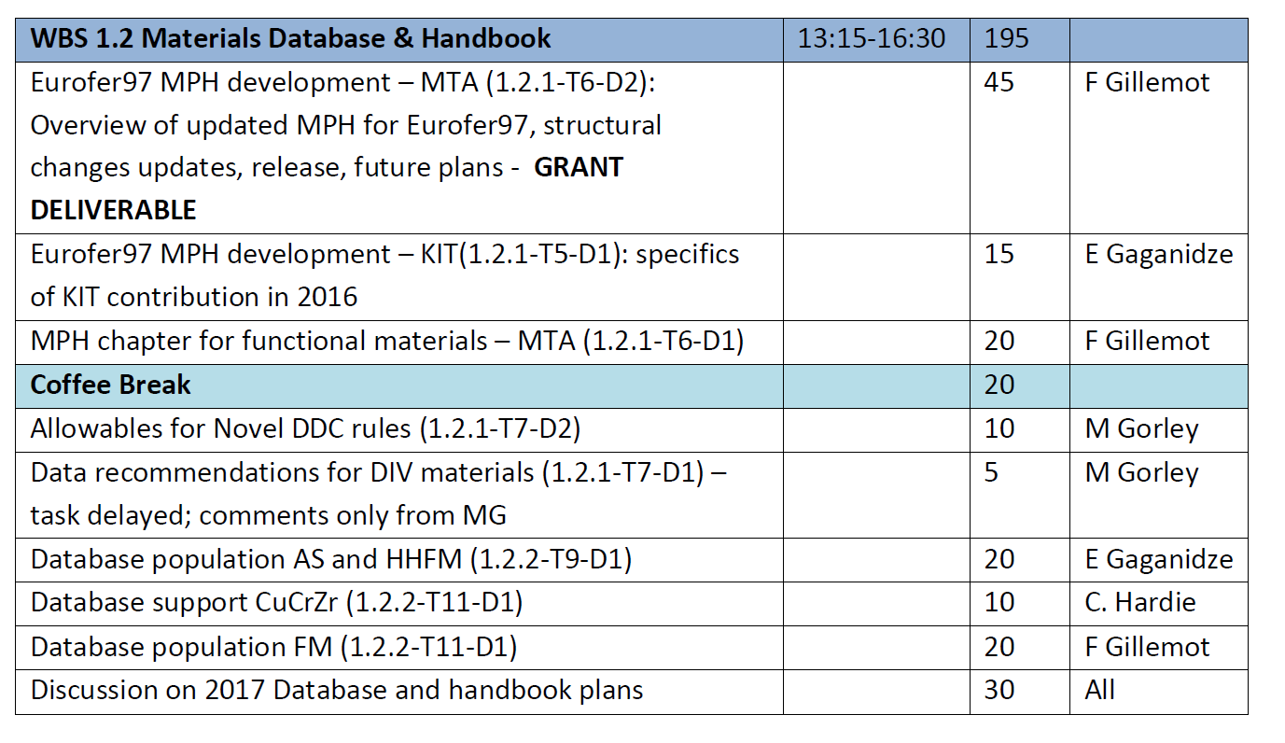
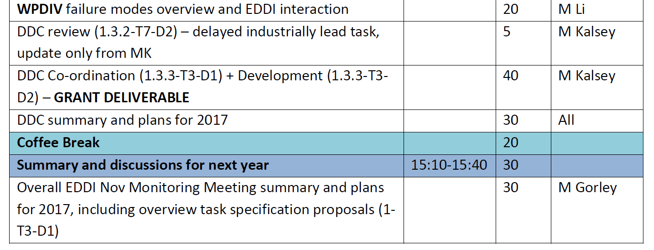
Agenda overview
WPMAT
← Day 1 (3rd Nov)
↓ Day 2 (4th Nov)

Slide 4
Aims of the meeting
WPMAT
Cover an overview of deliverables and summary of the years work (and any remaining work)
Highlight critical achievements, progress and issues
Review and consider deliverables for 2017 that support DEMO, WPMAT and EDDI requirements
End of year summary meetings are very demanding on time, please stick to allotted times!

Slide 5
EDDI Overview
WPMAT
1 Engineering Data & Design Integration
Lead: Mike Gorley
1.1:
Co-ordination & Interface Activities
Lead: Mike Gorley
1.2:
Material Database & Handbook
Lead: Ermile Gaganidze
1.3:
Structural Design Criteria, Codes & Standards
Lead: Manminder Kalsey
1.4:
Material Testing
Lead: Enrico Pirelli
1.1.1:
Co-ordination
1.2.1
Material Handbook
1.3.1:
Priority Gaps
1.4.1:
Test Planning & Implementation
1.1.2:
Material Management Framework & Qualification
1.2.2:
Material Database
1.3.2:
Enhancing Content & Usability
1.3.3:
DDC Development and Release

Slide 6
Summary of 2016 task specifications 1.1 & 1.2
WPMAT
Del. ID | Del. Title | Start Date | Due date | RU | Owner | ppy | ind | HW k€
1-T003-D001 | Summary report on EDDI Co-ordination for year 2016 | 01/01 | 31/10 | CCFE | Mike Gorley | 0.5
1.1.2-T004-D001 | Summary overview report on MTRL | 01/01 | 31/10 | CCFE | Mark Richardson | 0.2
1.1.2-T004-D002 | DEMO surveillance schemes | 01/01 | 31/10 | CCFE | Natalia Luzginova | 0.1
1.2.1-T005-D001 | Eurofer MPH developments | 01/01 | 31/10 | KIT | Ermile Gaganidze | 0.4
1.2.1-T006-D001 | MPH chapter for functional materials | 01/01 | 31/10 | MTA | Ferenc Gillemot | 0.3
1.2.1-T006-D002 | Eurofer 97 MPH chapter support | 01/01 | 31/10 | MTA | Ferenc Gillemot | 0.1
1.2.1-T007-D001 | Data Recommendations for WPDIV Materials | 01/04 | 31/10 | CCFE | --- | 0.2
1.2.1-T007-D002 | Allowables for Novel DDC Rules | 01/01 | 31/10 | CCFE | Natalia Luzginova | 0.2
1.2.2-T009-D001 | Database Population- AS and HHFM | 01/01 | 31/10 | KIT | Ermile Gaganidze | 0.3
1.2.2-T010-D001 | Database Support- CuCrZr | 01/01 | 31/10 | CCFE | Chris Hardie | 0.1
1.2.2-T011-D001 | Database Population- FM | 01/01 | 31/10 | MTA | Ferenc Gillemot | 0.2

Slide 7
Summary of 2016 task specifications 1.3 & 1.4
WPMAT
Del. ID | Del. Title | Start Date | Due date | RU | Owner | ppy | ind | HW k€
1.3.1-T004-D001 | Brittle Fracture | 01/01 | 31/10 | KIT | Marco Conte | 0.3
1.3.1-T005-D001 | Joint Assessment | 01/04 | 31/10 | CCFE | J Hess | 0.2
1.3.1-T005-D002 | Armour Assessment | 01/04 | 31/10 | CCFE | N Gupta | 0.2
1.3.1-T006-D001 | Creep Fatigue | 01/01 | 31/10 | KIT | Jarir Aktaa | 0.2
1.3.2-T007-D001 | Fatigue | 01/01 | 31/10 | CCFE | Mike Fursdon | 0.5
1.3.2-T007-D002 | Ratcheting | 01/01 | 31/10 | CCFE | James Gardiner | 0.3
1.3.2-T007-D003 | Plastic Flow Localisation | 01/04 | 31/10 | CCFE | Y Xue | 0.2
1.3.2-T008-D001 | Creep Fatigue Assessment | 01/01 | 31/10 | KIT | Michael Mahler | 0.5
1.3.2-T009-D001 | Grain Modelling Fatigue | 01/04 | 31/10 | CEA | C Robertson | 0.4
1.3.3-T003-D001 | DDC Coordination | 01/01 | 31/10 | CCFE | M Kalsey | 0.4
1.3.3-T003-D002 | DDC Development | 01/01 | 31/10 | CCFE | M Kalsey | 0.4
1.3.3-T004-D001 | DDC Review and Future Developments | 01/01 | 31/10 | CCFE (AMEC) | M. Kalsey (Paul Smith) |  | 0.5
1.4.1-T003-D001 | EDDI Testing Plan – ENEA | 01/01 | 31/10 | ENEA | Enrico Perelli | 0.6 |  | 40
1.4.1-T004-D001 | EDDI Testing Plan – KIT | 01/01 | 31/10 | KIT | Mario Walter | 0.3 |  | 80
1.4.2-T002-D002 | EDDI Testing Plan for 2015 (KIT) | 01/01 | 30/04 | KIT | Mario Walter | 0.3
 |  |  |  |  | Sub-Total (EDDI) | 7.4 | 0.5 | 120

Slide 8
EDDI 2016 big ticket items
WPMAT
WBS 1.1 – Update MTRL, enhance WPMAT and EDDI visibility & reputation
WBS 1.2 – Release of MPH V1 and V2, pilot FM MPH
WBS 1.3 – Initial rollout of tools/methodologies to designers, 1st draft release of DDC
WBS 1.4 – Round Robin testing (completion) and first results from initial “real” testing

Slide 9
Expectations
WPMAT
EDDI is was in its foundational years; good discussions, ideas and foresight are still required. A clear direction of EDDI’s support to DEMO design is increasingly requested
Face to face discussions can accelerate progress, please use this time to target the critical areas
Problem – solution approach is important
Feel free to arrange subsequent/follow up meetings as required

Slide 10
Many thanks and please enjoy the meeting
WPMAT

Slide 11
Back up slides
WPMAT

Slide 12
EDDI 2017 budget (as of now)
CCFE: 3.50 lab-ppy
(+ 0.5 ppy for sPL)
KIT: 2.0 lab-ppy, 40k HW
(HW to be converted into ppy – numbers unconfirmed)
Wigner RCP (HAS/MTA): 0.6 lab-ppy
ENEA-CNR: 0.6 lab-ppy, 20k HW
Industry (via CCFE): 0.5 Ind. ppy
FOM-NRG: 0.5 lab-ppy
(was down to zero on 2015 & 2016 – involvement unconfirmed)
CEA: 0.1 lab-ppy

Slide 13
EDDI within WPMAT
WPPMI & WPDIV & WPBB & WPPFC & ITER & F4E & …
Engineering Data and Design Integration
Advanced Steels
High Heat Flux Materials
Functional Materials
Irradiation Campaigns
Integrated Radiation Effects Modelling and Experimental Validation
Notes:
Comment on some direct interactions e.g. WPDIV and HHFM, and lack of direct interactions with ITER and F4E.

Slide 14
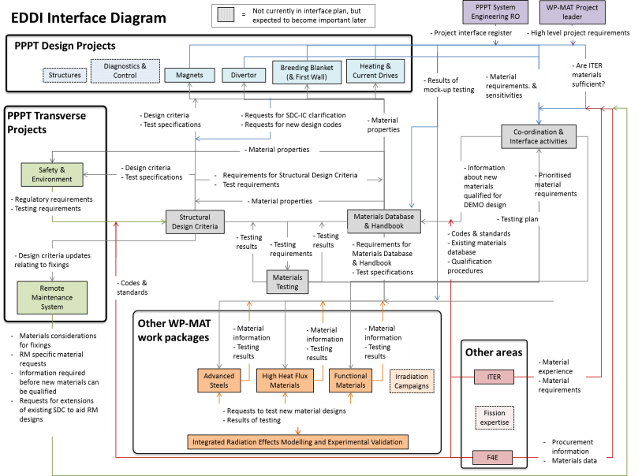
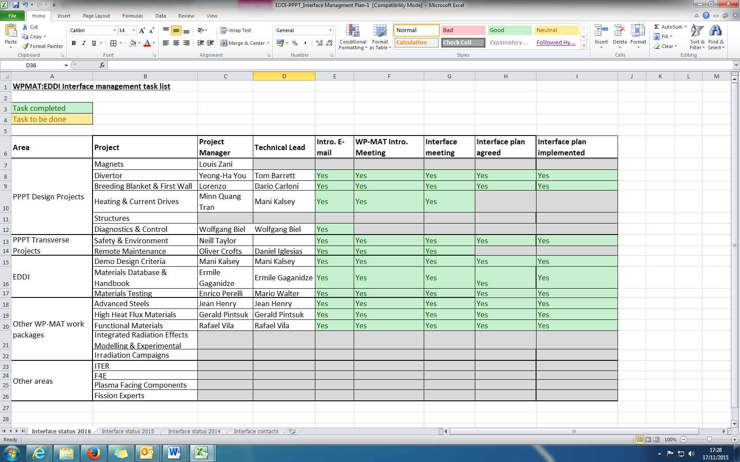
1.1 - Co-ordination and Interfacing
Coordination, communication, assistance
Involvement in all MAT groups
Close interaction with BB, DIV, …
Implementation of Systems Engineering approach in MAT
Readiness Levels
Evaluation system
Work to date will be covered in Materials Technology Readiness Levels talk later in the day

Slide 15
1.2 - Materials Database and Handbook
Database and Handbook
Development of a dedicated DEMO Materials Handbook
Transfer/continuation/modification of existing database activities
Gap analysis and design-specific experiments/characterisation
Ermile Gaganidze will cover this in more details in the proceeding talk.

Slide 16
1.3 - Structural Design Criteria, Codes & Standards
Design Criteria development (→ DEMO Design Criteria)
Evaluation of codes & standards
Analysis, adaptation, modification, extension of existing solutions in the fission programme
Survey and evaluation of experimental data and modelling approaches
Manminder Kalsey will cover this in more detail later in the workshop.

Slide 17
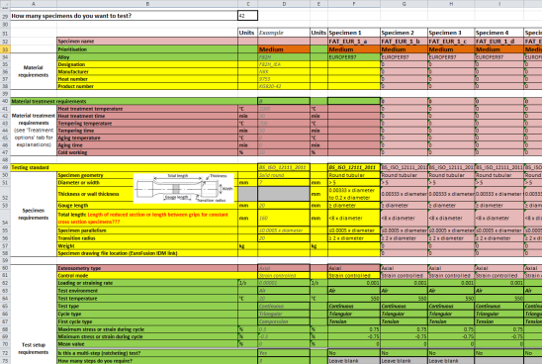
1.4 - Materials Testing
Materials testing campaigns to support engineering design and materials database. (Explicitly for non-irradiation testing)
Enable acquisition of materials data to fill: gaps in the database & Missing data validation to support new design rules
Work to date:
Development of a EDDI testing procedure
Round robin testing campaign using Eurofer 97 (ongoing)
Testing campaigns to support new design rules to start this year.
Research Unit | Tensile | Fracture toughness | Low Cycle Fatigue
KIT | Participating – tests performed | Participating | Participating
CIEMAT | Participating – tests performed |  | Participating
SCK-CEN |  |  | Participating
NRG | Participating – tests ongoing | Participating | Participating
MTA-HAS | Participating – tests ongoing | Participating
ENEA-CRN | Participating – tests performed |  | Participating
UPM |  |  | Participating
Notes:
Comment on nesesity for a slow start to the testing due to EDDI formative years but current extrapolation of testing campaigns to support critical DEMO data.

Slide 18
EDDI in 2016
DEMO Design Criteria (DDC) structure - released
New DDC tools progressed, based on prioritised gaps and step by step developments
MPH –Eurofer chapter updates, Functional Materials chapter drafted. New MPH version released
CuCrZr and W/W alloys chapters targeted for future years
Databases support: Advanced Steels, High Heat Flux Materials, Functional Materials & CuCrZr. Ready to provide designers up to date information
Materials testing to fill gaps in materials databased and support DDC developments

